Slide 1

AgriVision Core AI with Azure ML Studio
Anshika Jain
Philippa Burgess
Amit Kumar
Raghuraj Pratap Yadav
Notes:
Korrie

Slide 2
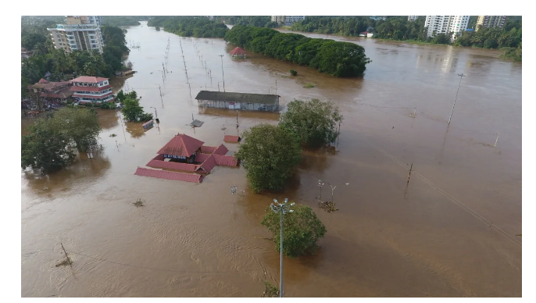
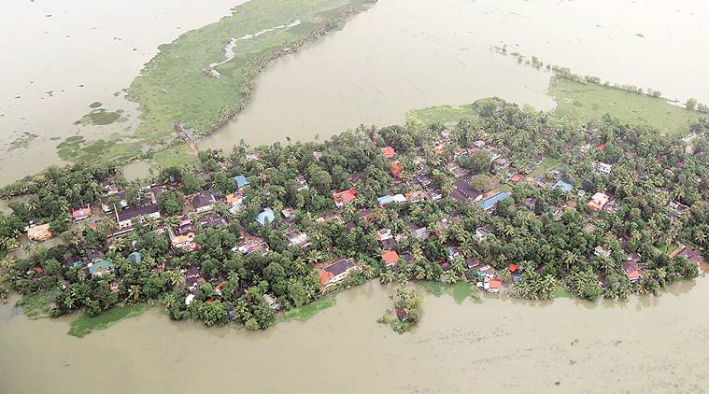
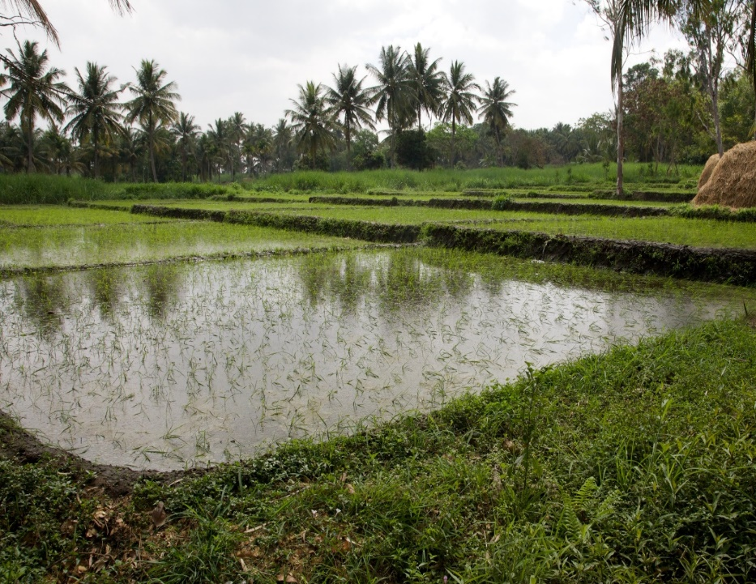
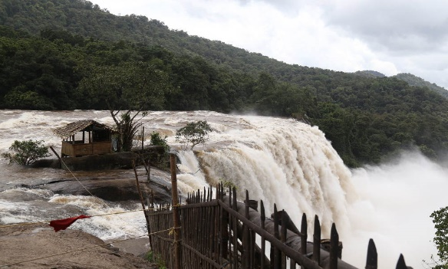
The Opportunity: ML for Satellite Imagery Analysis
2018 Kerala Floods in India: A devastating event causing severe agricultural and economic impacts
Beyond the immediate death toll of 435 lives, over 26,106 hectares (~100 square miles) of farmland were affected, risking the livelihood and food supply of nearly half of Kerala’s population of 35 million.
Ripple effects extended to India’s 1.4 billion people, with economic losses estimated at $95 million USD.
Climate impact suggests that such events will become more frequent and severe worldwide.
Notes:
Korrie
updated 7/21

Slide 3
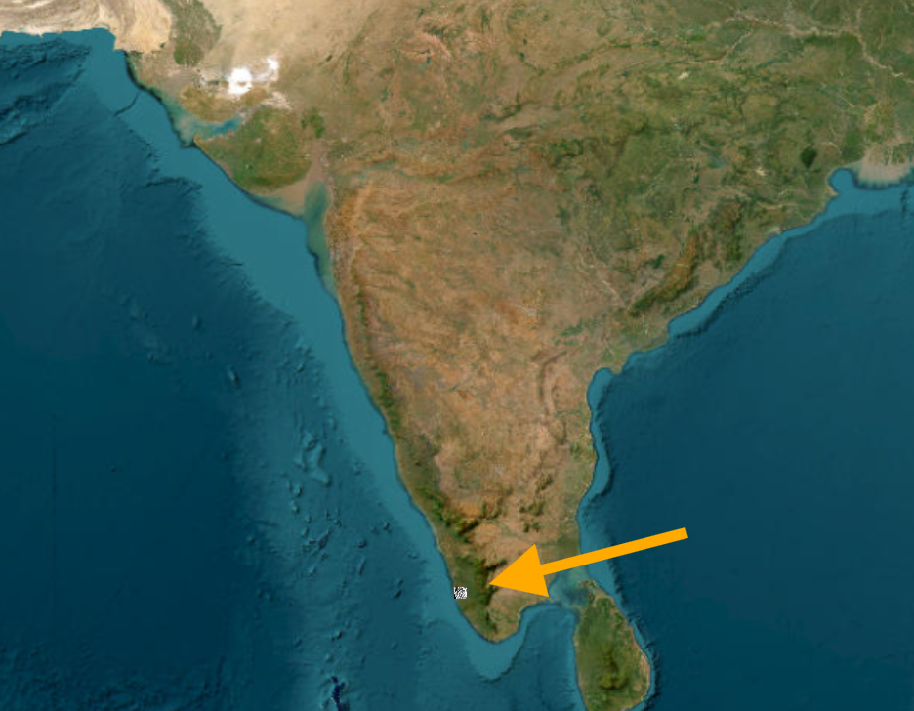
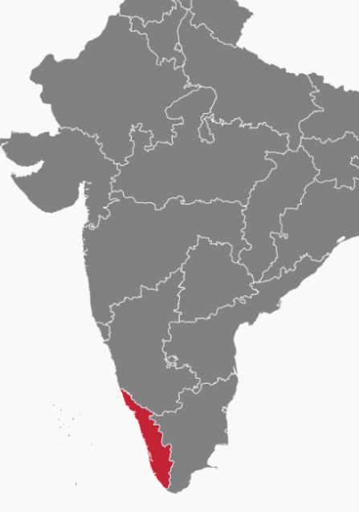
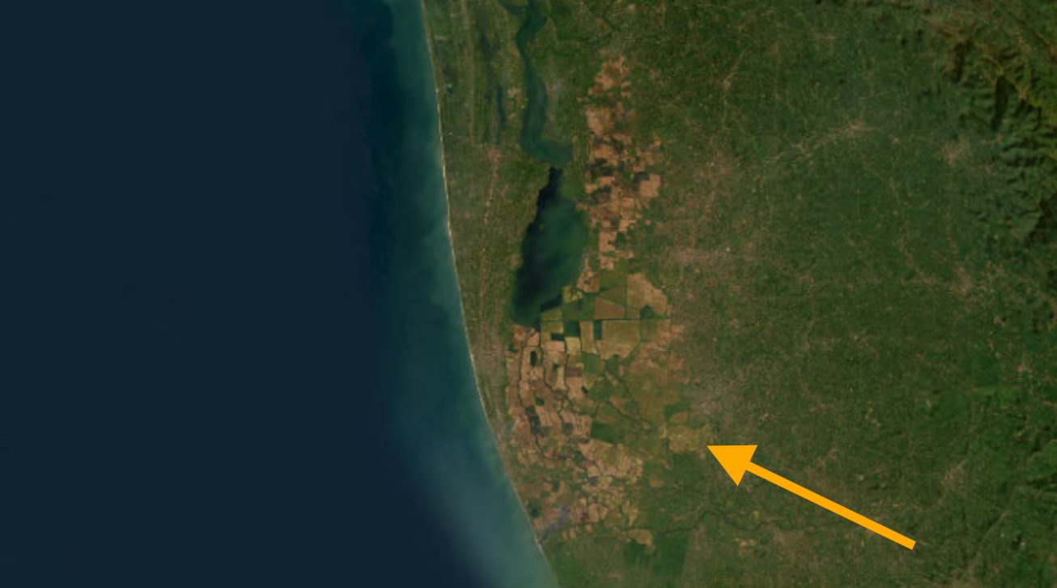
Study Area: Kerala 2018 Flood Impact
This case study is one example of Azure ML applications for government and industry to benefit
from satellite imagery analysis related to disaster resilience, emergency response, and recovery.
Partial map of India with state of Kerala in red
Kerala is a state in the southwest of India. It contains a significant amount of agricultural land.
Area: 15,005 sq miles (similar to Connecticut and New Jersey combined)
Density: 2332 people per sq mile (more than double King County, WA, which includes Seattle and Redmond)
Notes:
Korrie
updated 7/21

Slide 4
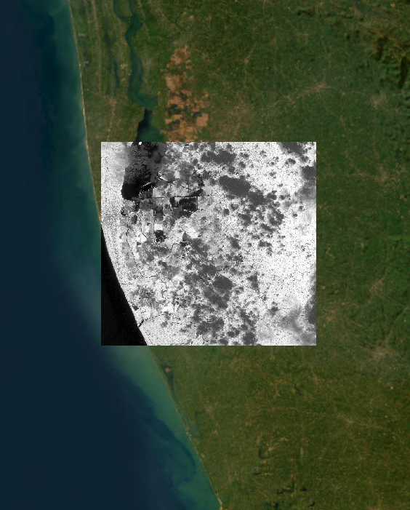
Solution: Technology and Methodology
AgriVision offers change analysis, categorization, counting, and predictive analysis using satellite imagery with multiple remote sensing bands available for analysis with Azure ML Studio
Our project aims to assess the impact of these floods on agricultural productivity using change analysis on Normalized Difference Vegetation Index (NDVI) data.
By analyzing NDVI we aim to provide insights into the extent of agricultural damage and the rate of recovery post-flood.
This application can help government agencies, industry, local communities, and policymakers improve disaster preparedness, response strategies, and agricultural planning to address human safety, financial loss prevention, and food security.
We utilize Azure Storage and Azure Machine Learning Studio which provides us with:
Foundational Models: Use of pre-trained models and other state-of-the-art models.
Speed & Efficiency: Saves cost to build from scratch and speeds up the process with access to large file storage for processing, training, and analysis.
Customization: Features to customize/fine-tune the model using custom scripts and more, with Python and options for CPU and GPU utilization.
Sentinel-2 satellite imagery of a section of Karala impacted by flood
Notes:
Korrie
updated 7/21

Slide 5
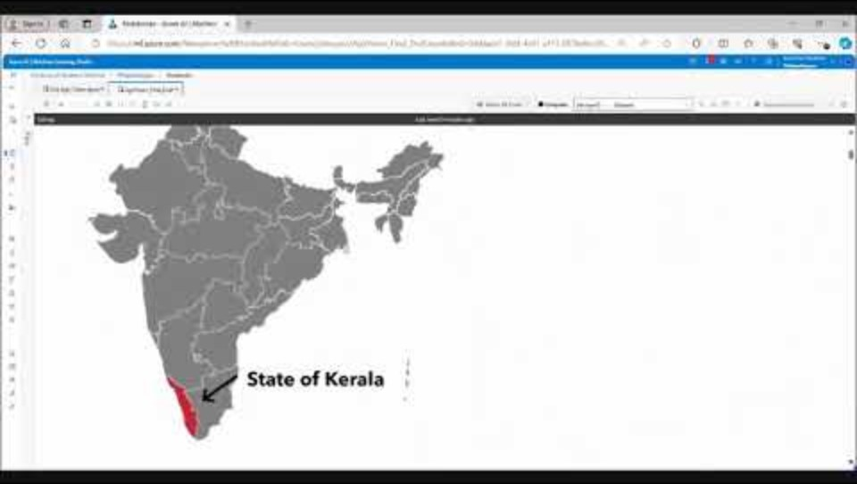
Demo: Azure Storage & Azure ML Studio Notebook
Notes:
Korrie
updated 7/21

Slide 6
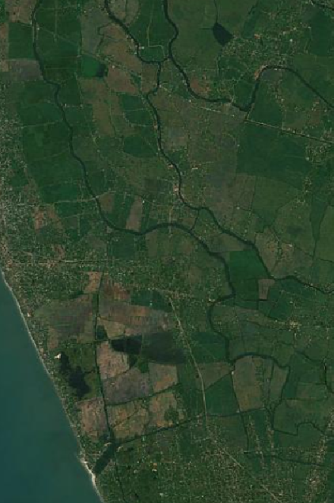
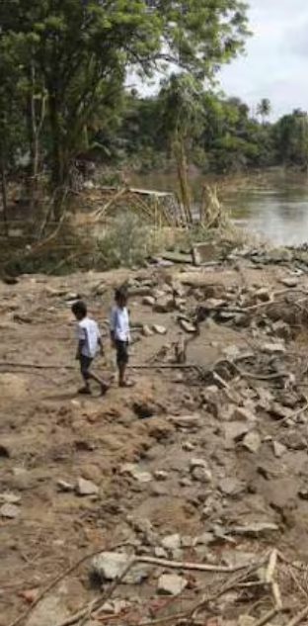
Key Takeaways and Recommended Action
Empowering Global Disaster Management and Human Security with Azure AI
Leverage Azure ML for Impact Analysis:
Enable local authorities to use Azure ML tools for and disaster impact analysis.
Integrate Insights into Policy and Planning:
Equip government, industry, communities and policymakers with accessible technology to ensure disaster preparedness and recovery response.
Enhance Efficiency and Cost-Effectiveness:
Streamline data processing, reduce costs, and deliver actionable insights.
Support Vulnerable Populations:
Promote low-cost, scalable methods for disaster preparedness and recovery to underserved populations including those in developing countries such as India.
Achieve Long-Term Benefits:
Achieve ROI for sustainable disaster management to protect lives and agriculture
Stop/Start:
Stop relying solely on traditional methods for disaster management and start integrating advanced analytics and remote sensing data into regular monitoring.
Self-Sufficiency, Efficiency and Cost Reduction:
Empower local authorities, simplify workflows, and reduce IT infrastructure needs.
Kerala agricultural land. Inset: Children in Karela amid destruction of local rice paddy, banana and spices fields
Notes:
Korrie
updated 7/21

